Slide 1
PAwBRoFL : Exploring Performance Aware Byzantine-Robust Federated Learning
CSCI 6962 Fall 2024 Group Project
Heshan Fernando, Zhengjie Xiong, Aarnav Patel, Shane Stoll

Slide 2
Content
Introduction
Motivation
Proposed Framework
Related Work
Technical Foundations
Methodology
Experimental Setup
Results
Discussion
References

Slide 3
Introduction
What is Federated Learning (FL)?
Decentralized ML training; data remains to local devices.
Key advantages: Enhanced privacy and reduced data transfer.
Challenges in FL:
Vulnerable to Byzantine adversaries: malicious or unreliable clients corrupting updates.
Our objective:
Introduce PAwBRoFL: Integrating performance-awareness into Byzantine-robust FL.

Slide 4
Motivation
Byzantine adversaries can:
Disrupt global models through malicious updates.
Lead to performance degradation across clients.
Current Limitations:
Existing Byzantine-robust methods focus solely on attack resistance.
Lack of client performance-awareness in global model updates.

Slide 5
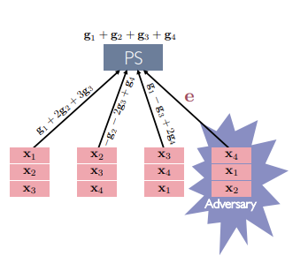
Related work (Byzantine)
3 main strategies to counter Byzantine attacks
Redundancy
Ensure that malicious clients effects are minor compared to good clients
Trusting a few select clients each iteration
Compare gradients to known non-adversarial data/clients_{[2]}
Robust Aggregation Algorithms
Spreading gradient updates across different clients to reduce the impact of an adversarial client_{[1]}
[1]Lingjiao Chen, Hongyi Wang, Zachary Charles, and Dimitris Papailiopoulos. Draco: Byzantine-resilient distributed training via redundant gradients
[2] Nikola Konstantinov and Christoph Lampert. Robust learning from untrusted sources, 2019

Slide 6
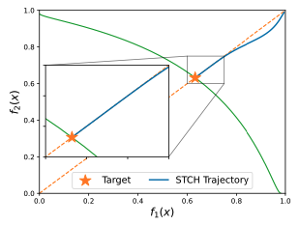
Related work (Performance Awareness)
In this project, "performance awareness" refers to the process of optimizing the worst-performing objective among a set of objectives to be optimized (details provided later) (Lin et al. 2024).
In federated learning, some studies aggregate model parameters based on client performance metrics like
Quality (Deng et al., 2021)
Computing power (Seo et al., 2022),
but these performance concepts are beyond the scope of this project.
Image from Lin, Xi, et al. "Smooth Tchebycheff Scalarization for Multi-Objective Optimization." arXiv preprint arXiv:2402.19078(2024).

Slide 7
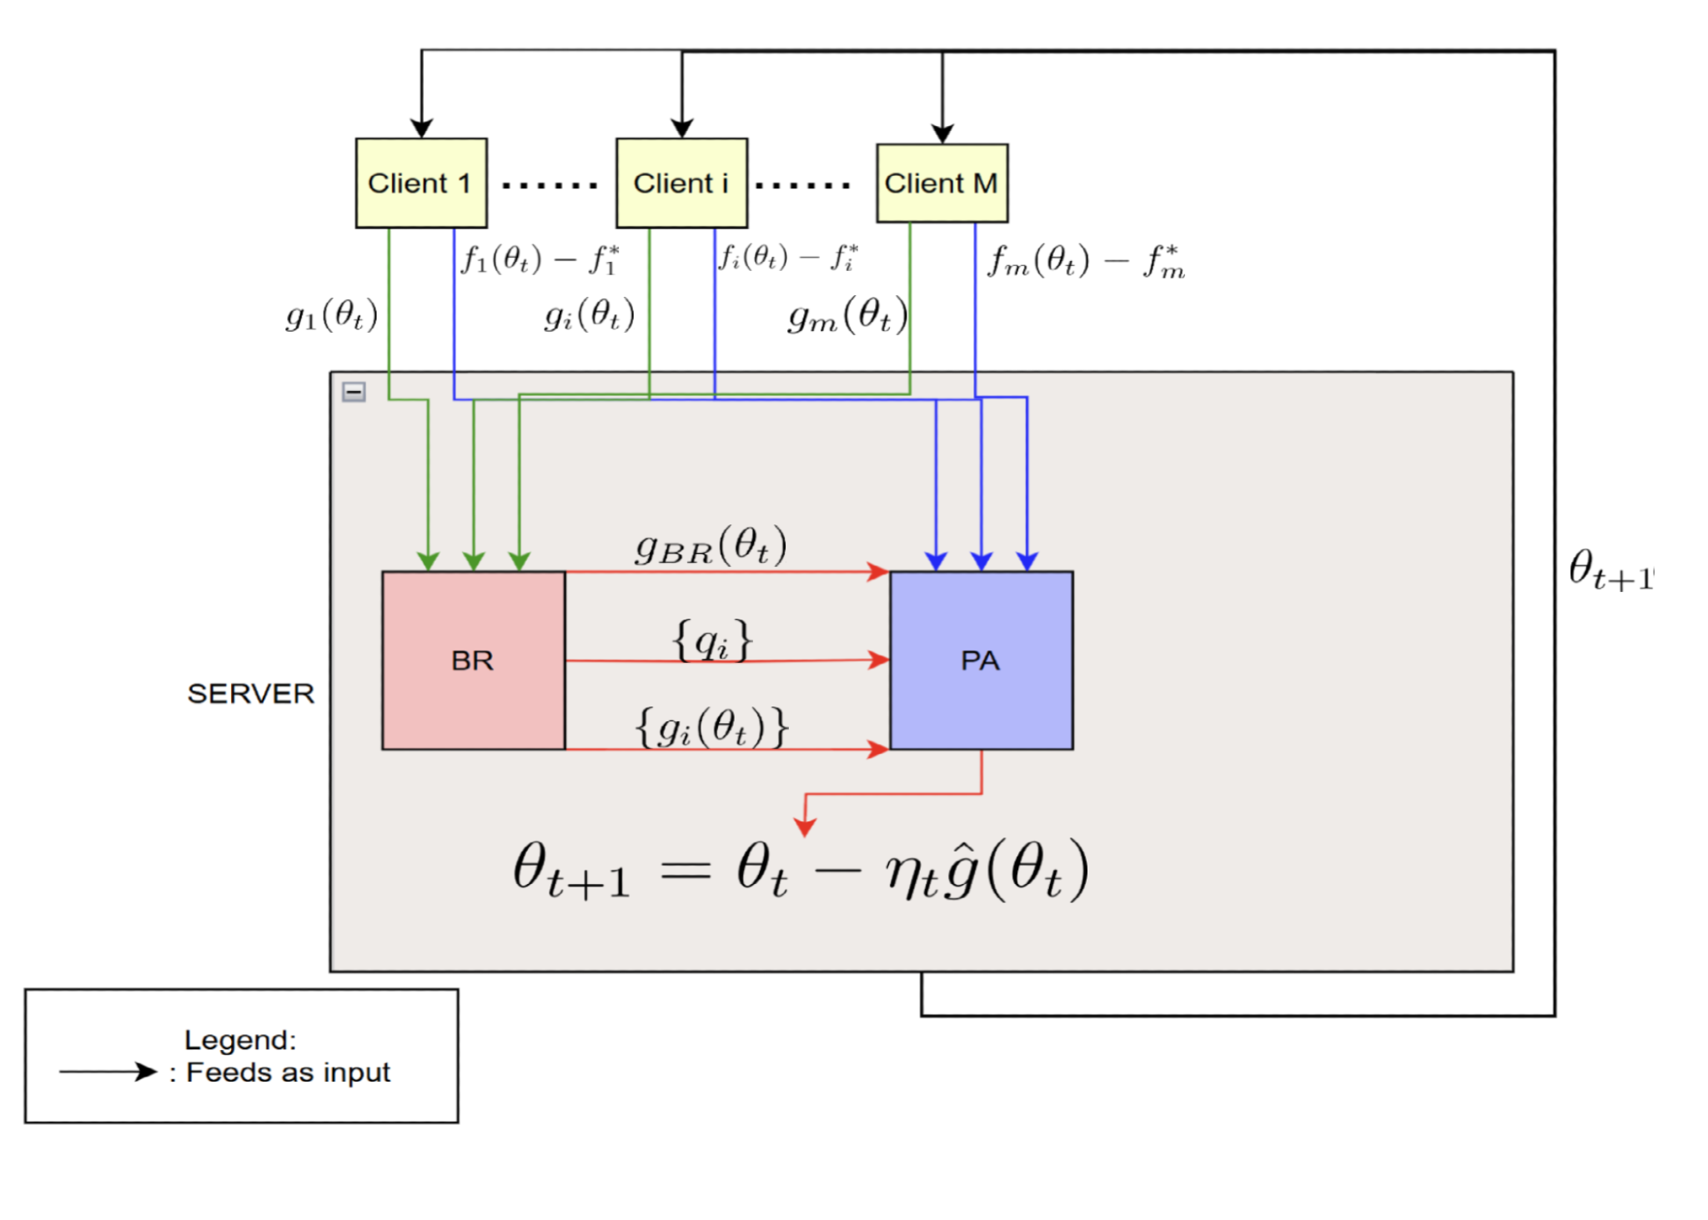
Proposed Framework
PAwBRoFL:
Combines performance awareness with Byzantine robustness

Slide 8
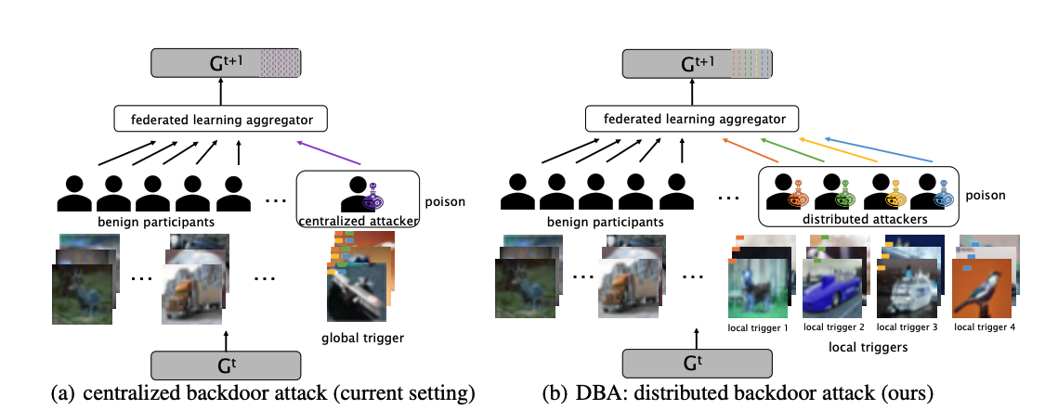
Technical foundations
Model poisoning and attack:
Distributed Backdoor Attack (DBA) Xie et al. (2019)

Slide 9
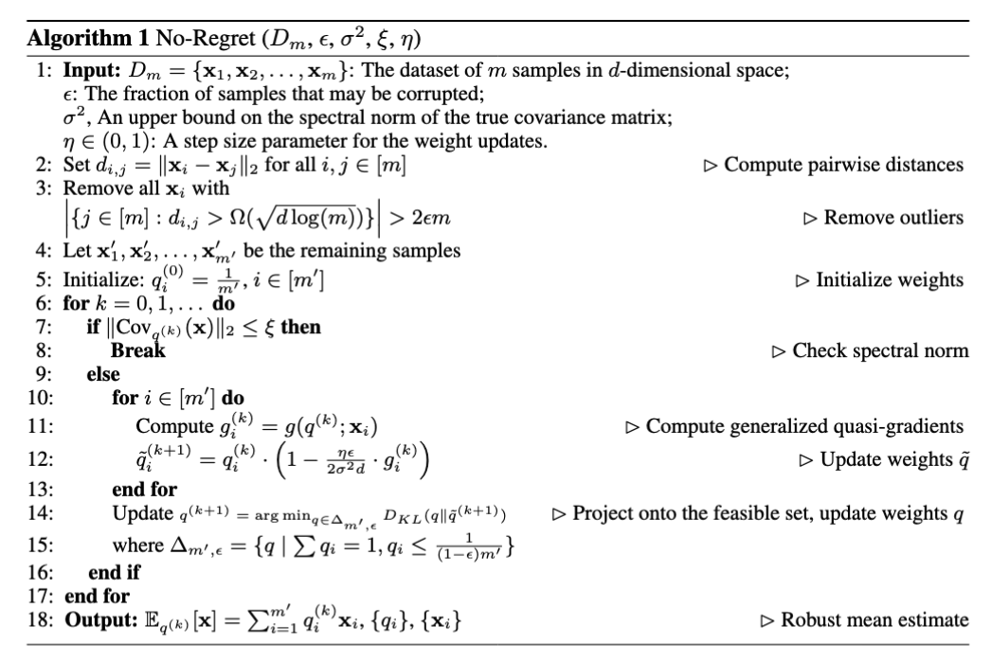
Technical foundations (Cont.)
Robust Aggregation
No-Regret Algorithm
Hopkins et al. (2020)
Filtering Algorithm
Diakonikolas et al. (2017)
From Zhu et al. (2023)

Slide 10
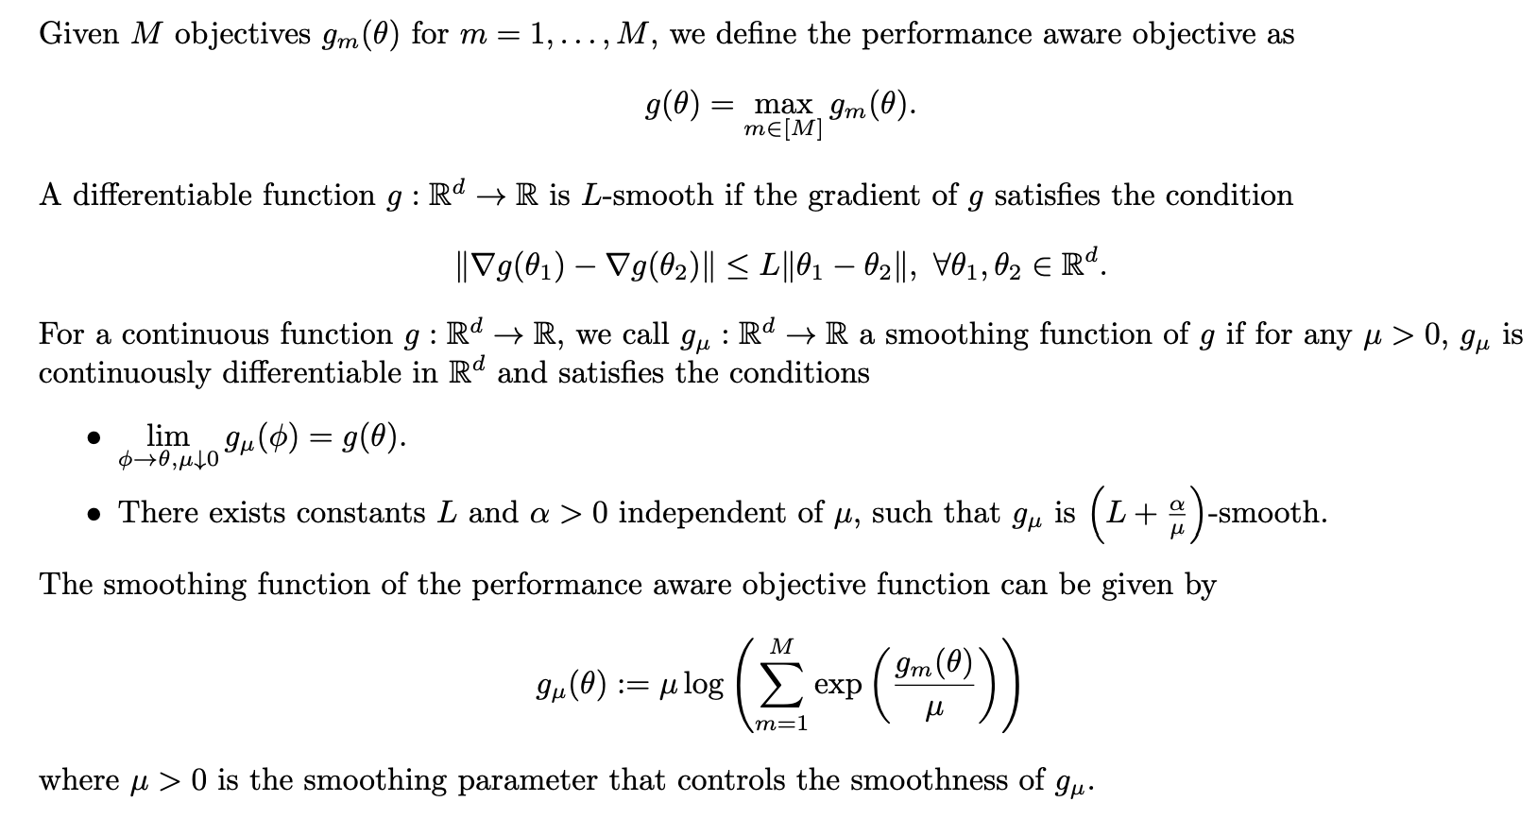
Technical foundations (Cont.)
(Lin et al. (2024))

Slide 11
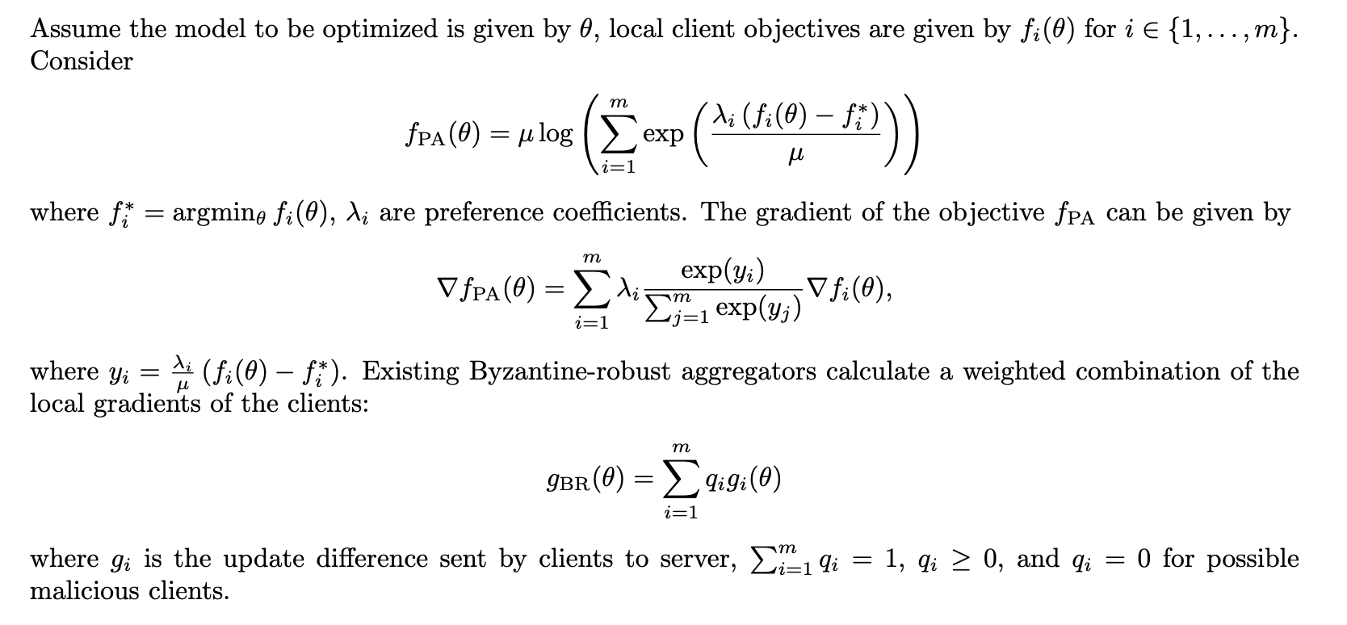
Methodology

Slide 12
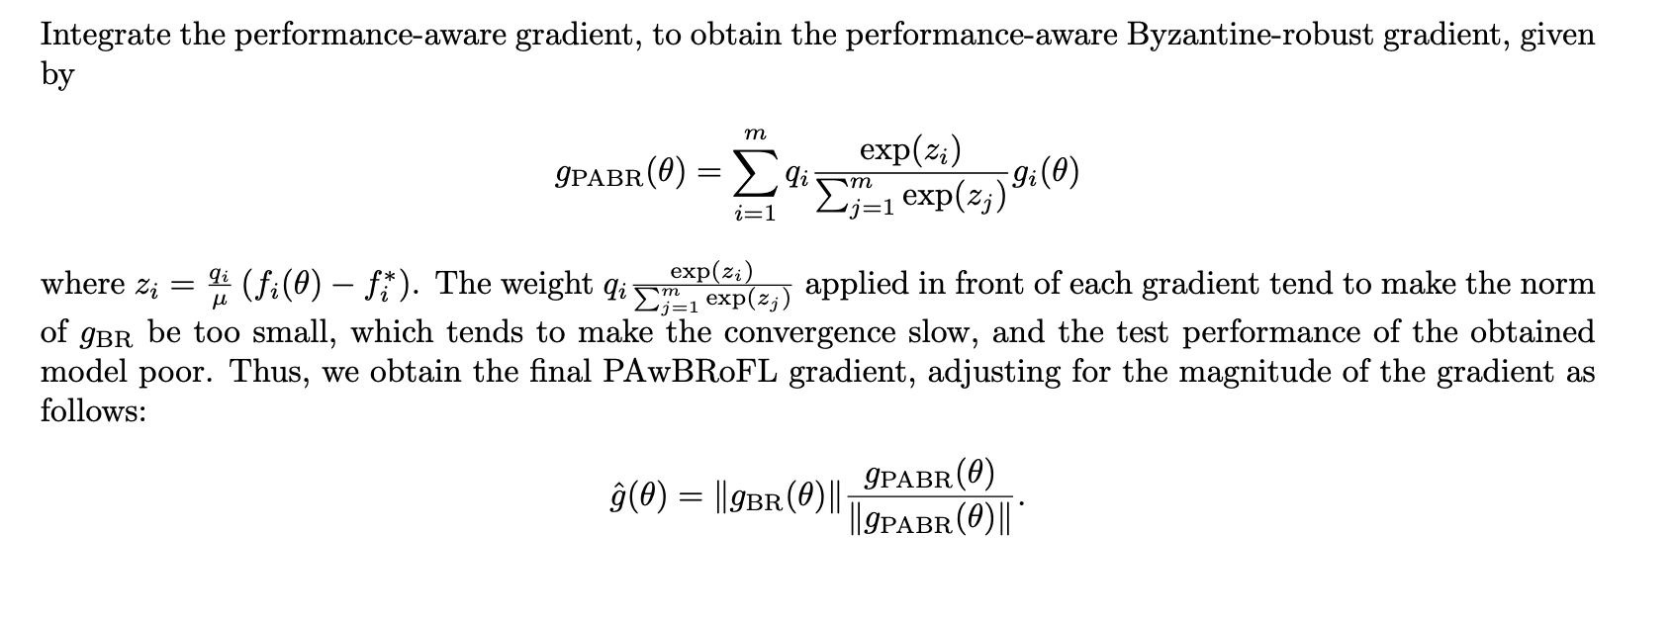
Methodology (Cont.)

Slide 13
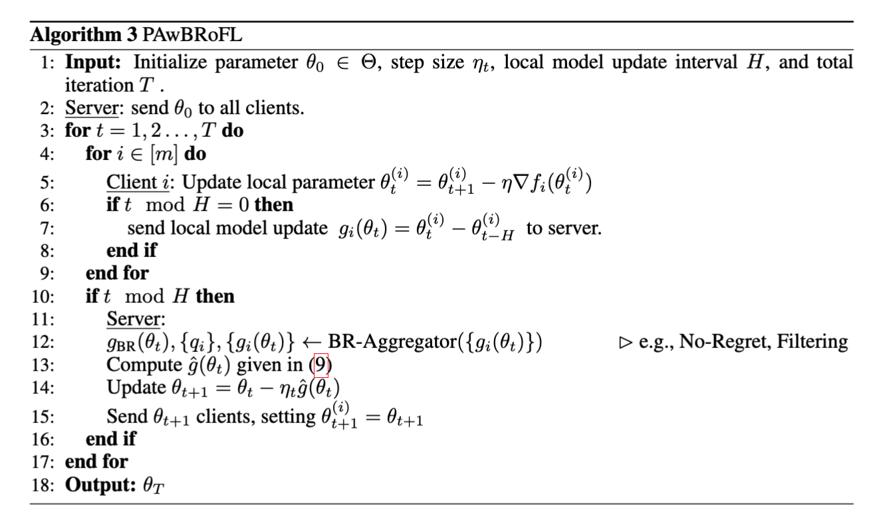
Methodology (Cont.)

Slide 14
Experimental Setup
Utilizated MNist & Fashion MNist Datasets evenly spread across 100 Clients
Attack Type: Distributed Backdoor Attack
varied in both number of malicious clients, as well as aggressiveness of attacks
Evaluation Metrics:
Test Accuracy
Attack Success Rates
Client Optimality Gap
The difference between the theoretically best achievable value had there been no attacks, and current model’s performance
3 scenarios: No attack, Attack w/ No Regret, Attack w/ Filtering

Slide 15
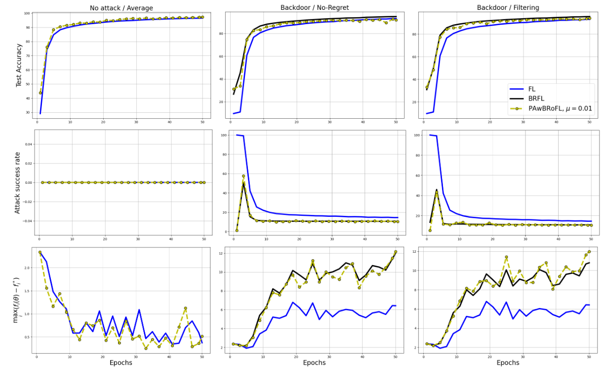
Results (MNIST)
vanilla Fed Learning (solid blue),
vanilla BR Fed Learning (solid black),
PAwBRoFL method (dashed yellow with circle marker).
Top Row: test accuracy performance (HIGH)
Middle row: Attack success rate (LOW)
Bottom row: maximum local optimality gap (LOW)

Slide 16
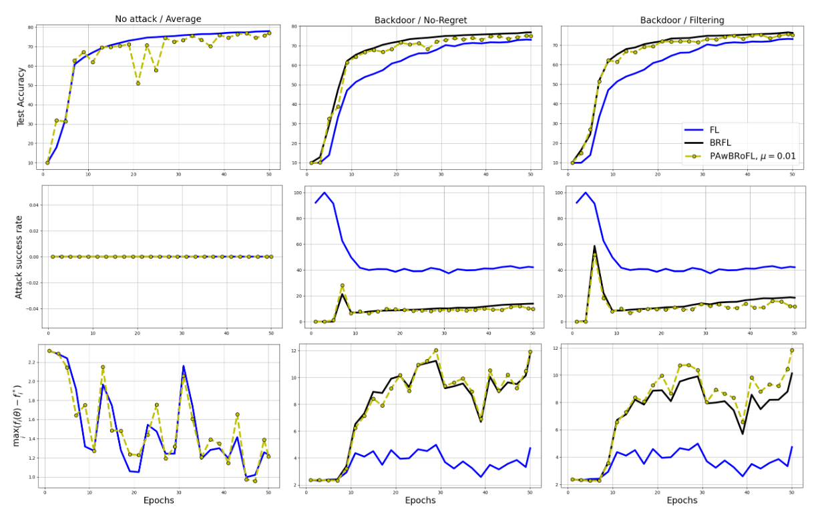
Results (Fashion-MNIST)
vanilla Fed Learning (solid blue),
vanilla BR Fed Learning (solid black),
PAwBRoFL method (dashed yellow with circle marker).
Top Row: test accuracy performance (HIGH)
Middle row: Attack success rate (LOW)
Bottom row: maximum local optimality gap (LOW)

Slide 17
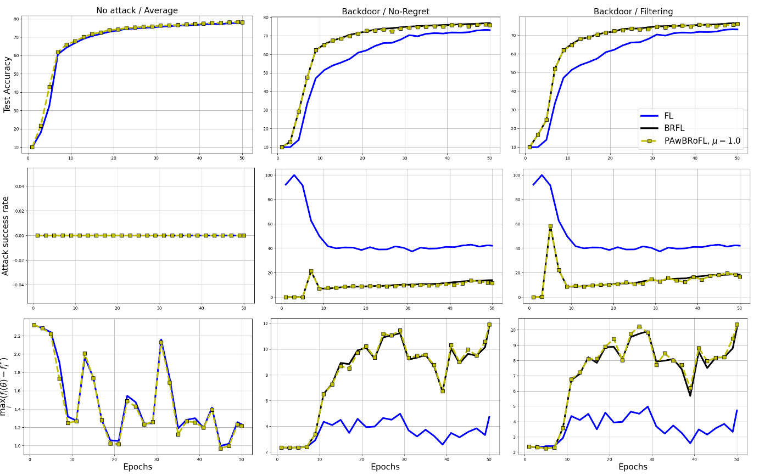
Results (Fashion-MNIST)
vanilla Fed Learning (solid blue),
vanilla BR Fed Learning (solid black),
PAwBRoFL method (dashed yellow with circle marker).
Top Row: test accuracy performance (HIGH)
Middle row: Attack success rate (LOW)
Bottom row: maximum local optimality gap (LOW)

Slide 18
Discussion
PAwBRoFL gives a basic foundation for integrating performance awareness with Byzantine robustness in FL setting
PAwBRoFL’s performance varies between datasets
Hyper-parameter tuning?
Dynamic temperature parameterization?
Exploring other metrics of performance (EX: Validation loss gap, gradient norm) would be interesting future work

Slide 19
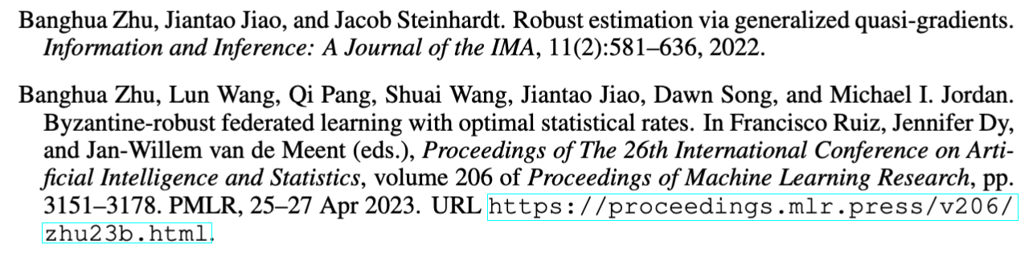
References
See report for complete list of reference.

